Slide 1
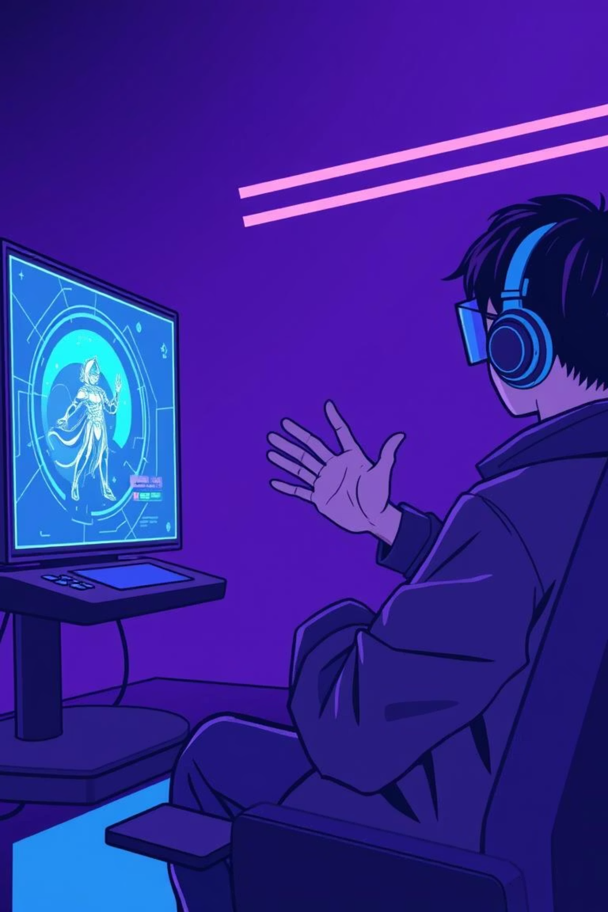
BhaRaNi Hand Gesture Gamingaaaaaaaaaaaaaaaaaaaaaaaaaaaaaaaaaaaaaaaaaaaaaaaaaaaaaaaaaaaaaaaaaaaaaaaaaaa
•2310030079- A. Nikhil Sai Ram Reddy
•2300031263- Ayush Kumar
Under the supervision of
Dr. Sumit Hazra

Slide 2
Project Overview
BhaRaNi Hand Gesture Gaming
•Objective: To create a gesture-controlled gaming platform using hand gestures and deep learning.
•Key Features:
•Real time gesture recognition
•Gesture-based game control
•Authentication with JSON Web Token (JWT)
•Performance analytics visualization
•Use Case: Enhancing gaming accessibility and user experience with touchless controls.

Slide 3
Under the Hood: Our Technology Stacks
•Frontend: React + Vite
•Backend: Spring Boot (Java REST API’s)
•Authentication: JSON Web Token (JWT) (Secure Token-based Login)
•Database: MongoDB (User &Analytics Data)
•Machine Learning: Python with TensorFlow/Keras (Gesture classification)

Slide 4
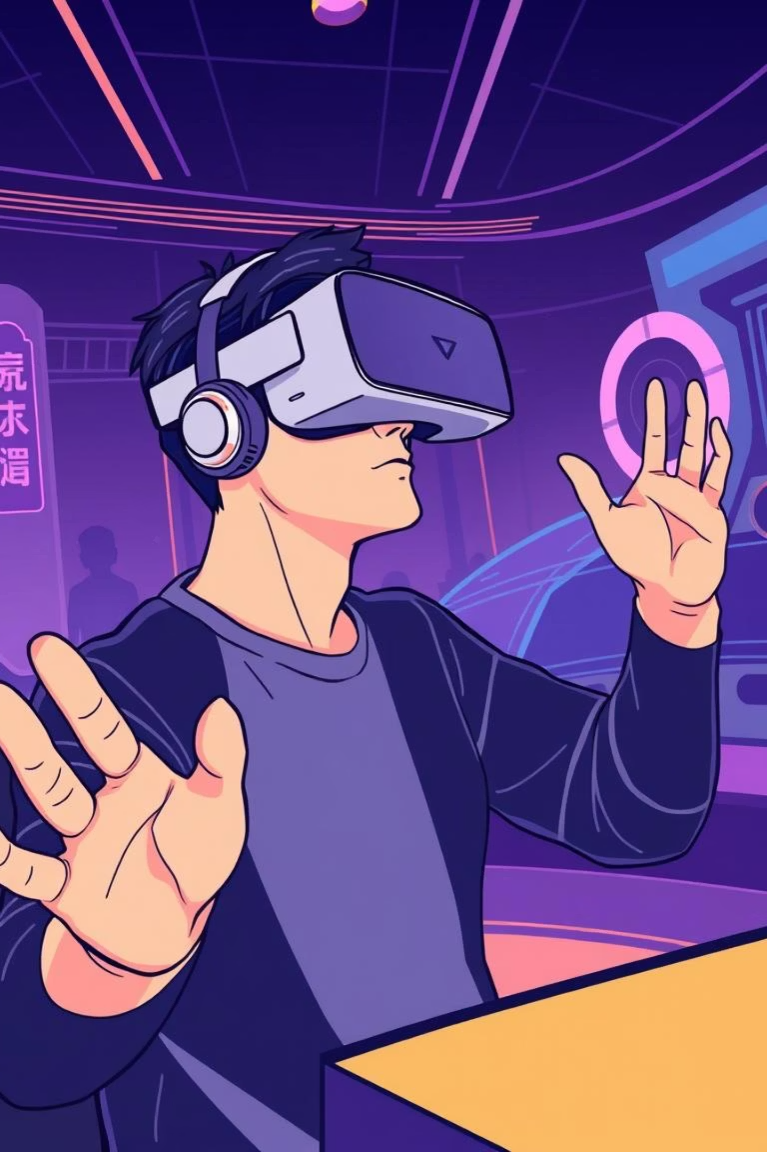
Games & Experiences
•Rock-paper-scissor.
•Piano Playing.
•Hand gesture drawing.

Slide 5





How It Works: The Gesture Recognition Pipeline
1
2
3
Webcam Capture
Python Model
Spring Boot
Real-time gesture input.
Classifies the gestures.
Handles API requests and stores data in MongoDB.
4
5
React + Vite
Visualization
Provides game interface and analytics dashboard.
Charts display accuracy, game scores, and performance logs.
This real-time feedback loop ensures high accuracy and responsive control, transforming your hands into the ultimate gaming interface.

Slide 6
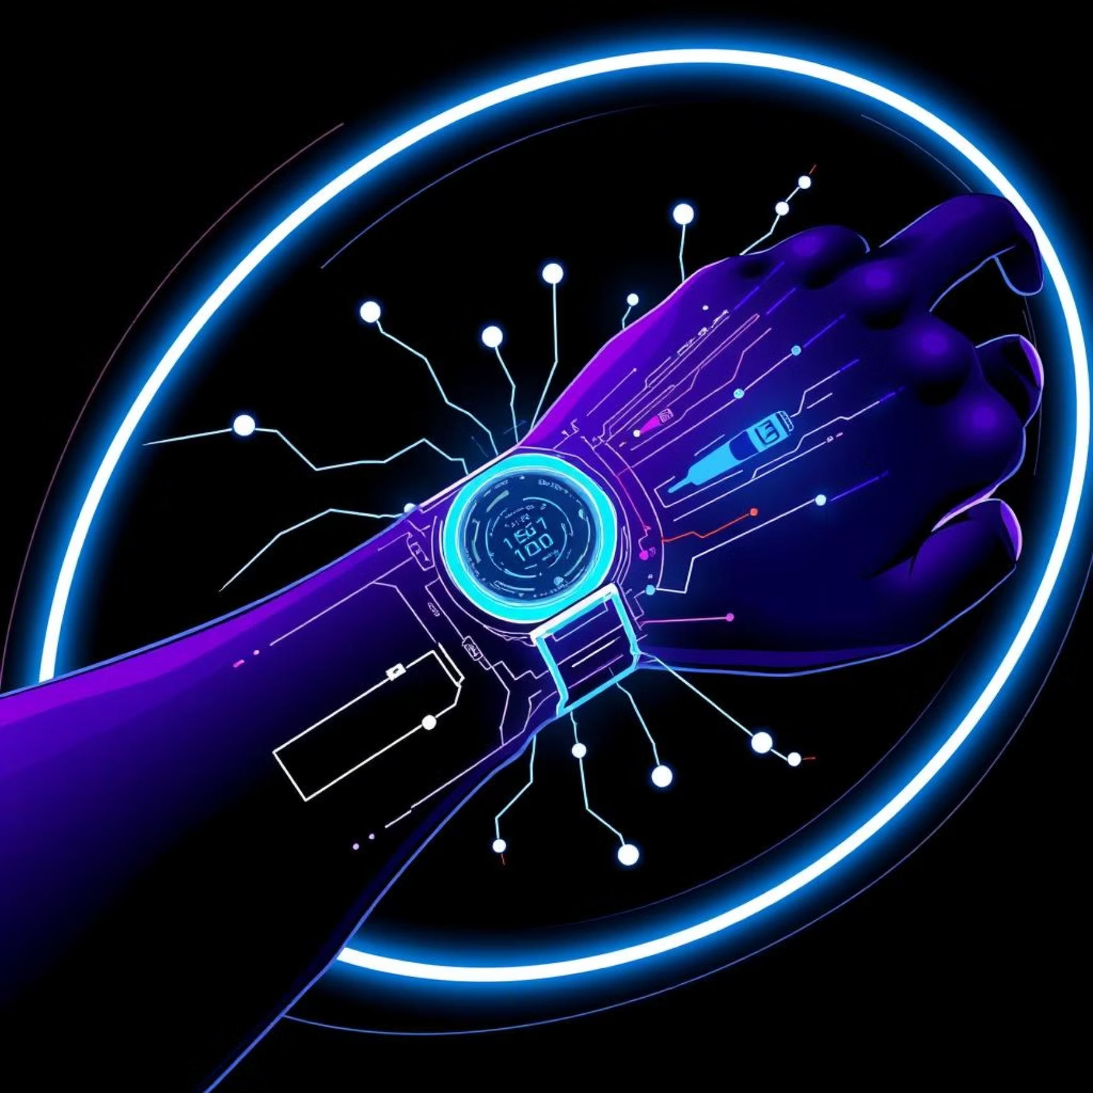
Future Scope: Evolving the Gaming Experience
Precision Control: Integrating neural input wristbands for finer, lighter, and more accurate gesture recognition.
Wearable Integration: Expanding into AR glasses and other wearable devices for truly seamless, omnipresent interaction.
Smarter AI: Developing enhanced AI models that adapt to individual player gestures, reducing fatigue and improving naturalness.
Genre Expansion: Broadening support for more game genres and enabling complex multiplayer gesture interactions.
Accessibility Focus: Continuous improvements to make gesture gaming a truly inclusive platform for users of all abilities.

Slide 7
Conclusion
Cutting-Edge Technology
Natural Control
BhaRaNi leverages advanced gesture recognition and AI for deeply immersive gaming.
Combines vision sensors and AI for intuitive, contactless interaction.
Market Innovation
Future Vision
Positioned to lead in VR/AR and revolutionize mainstream gaming.
Committed to enhancing precision, comfort, and accessibility in gaming.
BhaRaNi is not just playing games; it's changing how we play.

